Slide 1
UPPER SIXTH ARTS
GEOGRAPHY
Practical Work 4
Calculating Demographic Indices
Notes:
Good morning, class, and welcome to our geography lesson. I am your geography teacher, Mr Kamdem. Today we are starting Practical Work 4: Calculating Demographic Indices.

Slide 2
CLASS INFO
Class, Chapter and Duration
Class | Upper Sixth Arts
Chapter | Module 4: Understanding and managing population dynamics across the world in general and Cameroon in particular
Duration | 2 periods (2 × 50 minutes)
Notes:
This lesson is for Upper Sixth Arts. It belongs to Module 4: Understanding and managing population dynamics across the world in general and Cameroon in particular. We shall need 2 periods to cover it.

Slide 3
IDENTIFICATION
Lesson Identification
Topic | Population Change over Time (Population Growth)
Sub-topic | Population Growth
Lesson | Practical Work 4: Calculating Demographic Indices
Notions / Concepts | Crude birth rate, crude death rate, fertility rate, fecundity, growth rate, doubling time, projection, net migration.
Syllabus focus | Calculate fertility, birth rate, mortality, growth rate, doubling time, projections and net migration.
Competence | Learners are able to calculate and interpret the main demographic indices.
Notes:
Our topic is Population Change over Time (Population Growth), and the sub-topic is Population Growth. The key notions we shall use today are: crude birth rate, crude death rate, fertility rate, fecundity, growth rate, doubling time, projection, net migration. At the end, you should be able to do this: learners are able to calculate and interpret the main demographic indices.

Slide 4

HOMEWORK CORRECTION
Correction of the Homework
Question (Lesson 9: Population Growth and its Determinants):
Draw the population change system for your village or town.
Notes:
Before we start the new lesson, let us correct the homework I gave you at the end of Lesson 9: Population Growth and its Determinants. The question was: Draw the population change system for your village or town. Take out your exercise books.

Slide 5
HOMEWORK CORRECTION
Correction: Possible Answer
Village system: inputs – births and people coming back from town; outputs – deaths and young people leaving for towns; store – the village population.
Notes:
Here is a good answer. Village system: inputs – births and people coming back from town; outputs – deaths and young people leaving for towns; store – the village population. Compare it with your own answer and correct your work in red.

Slide 6
LESSON PLAN
Lesson Plan
Correction of the homework
Objectives and recall
Real-life situation and action to take
Learning activities
Board summary
Evaluation, remediation and homework
Notes:
Here is the plan of our lesson today. First, we shall correct the homework. Then we shall look at the objectives and recall what you already know. After that, we shall study a situation from real life and the action to take, and do the learning activities. Finally, we shall copy the board summary, do the evaluation and the remediation, and I will give you the homework.

Slide 7
OBJECTIVES
Objectives
By the end of this lesson, you should be able to:
Calculate CBR, CDR and natural increase.
Calculate doubling time and make a simple projection.
Notes:
Take your time to copy this part; we will continue together.

Slide 8
OBJECTIVES
Objectives (continued)
Calculate net migration and interpret results.
Notes:
By the end of this lesson, you should be able to do three things. Number 1: calculate CBR, CDR and natural increase. Number 2: calculate doubling time and make a simple projection. Number 3: calculate net migration and interpret results.

Slide 9
PREVIOUS KNOWLEDGE
Previous Knowledge
Change = births − deaths + net migration.
Rates are often given per 1,000 people.
Notes:
Let us first remember what you already know. Change = births − deaths + net migration. Rates are often given per 1,000 people. Keep this in mind, because we shall build on it today.

Slide 10
REAL-LIFE SITUATION
Situation in Real Life
A region has 1,000,000 people. In one year there were 36,000 births and 9,000 deaths. The planning office asks the class to calculate the growth rate and when the population will double.
Notes:
Listen carefully to this situation from real life. A region has 1,000,000 people. In one year there were 36,000 births and 9,000 deaths. The planning office asks the class to calculate the growth rate and when the population will double. Think about it, because I am going to ask you some questions.

Slide 11
REAL-LIFE SITUATION
Situation: Question 1
What is the problem in the situation?
Notes:
Question 1: What is the problem in the situation? Think for a moment, then raise your hand to answer.

Slide 12
REAL-LIFE SITUATION
Answer
The class must calculate demographic indices.
Notes:
Good. The class must calculate demographic indices.

Slide 13
REAL-LIFE SITUATION
Situation: Question 2
What is the first index to calculate?
Notes:
Question 2: What is the first index to calculate? Think for a moment, then raise your hand to answer.

Slide 14
REAL-LIFE SITUATION
Answer
The crude birth rate.
Notes:
Good. The crude birth rate.

Slide 15
REAL-LIFE SITUATION
Situation: Question 3
How can we find the doubling time?
Notes:
Question 3: How can we find the doubling time? Think for a moment, then raise your hand to answer.

Slide 16
REAL-LIFE SITUATION
Possible Answer
70 ÷ growth rate (%).
Notes:
Good. 70 ÷ growth rate (%).

Slide 17
ACTION TO TAKE
Action to Take
Calculate demographic indices to describe population change.
Notes:
From this situation, the action we are working towards in this lesson is the following: calculate demographic indices to describe population change.

Slide 18
JUSTIFICATION
Justification of the Lesson
This practical work helps us to use numbers to understand population change.
Notes:
Why is this lesson important for you? This practical work helps us to use numbers to understand population change.

Slide 19
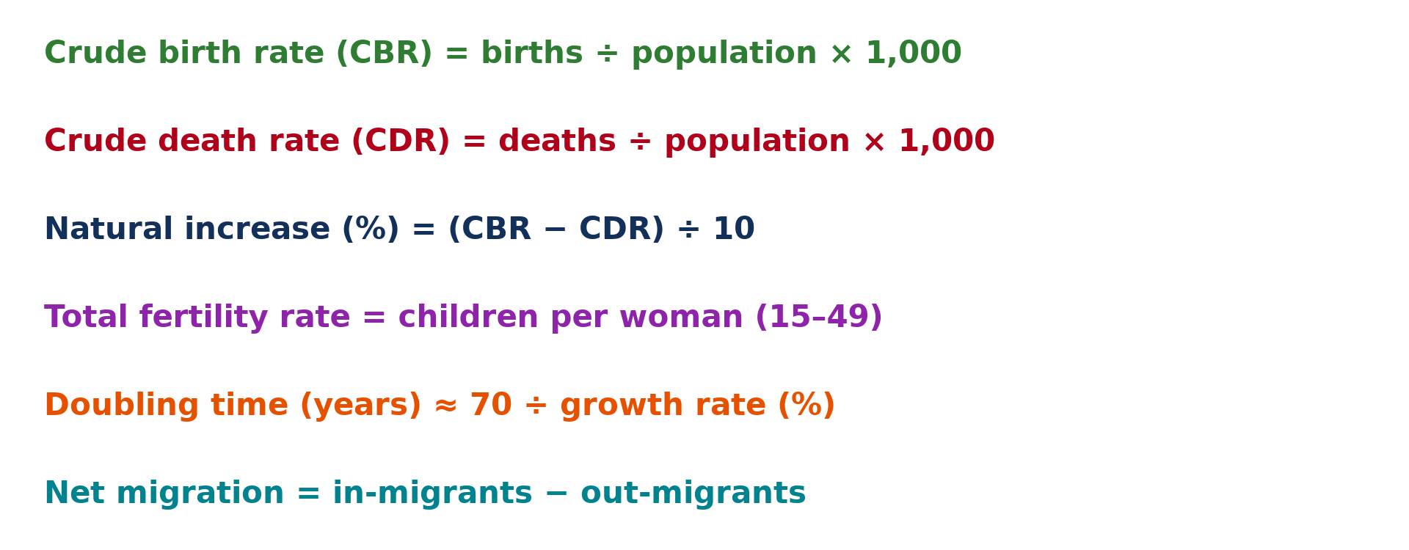
1. FORMULAS
Activity 1
The main demographic indices.
Notes:
Activity 1. Look carefully at this diagram: the main demographic indices. Observe every detail before I ask the question.

Slide 20
1. FORMULAS
Activity 1: Question
Why are birth and death rates given per 1,000?
Notes:
Here is the question for Activity 1: Why are birth and death rates given per 1,000? Take one minute to think and write your answer in your rough notebook.

Slide 21
1. FORMULAS
Activity 1: Answer
To compare places with different population sizes.
Notes:
Let us check the answer together. To compare places with different population sizes.

Slide 22
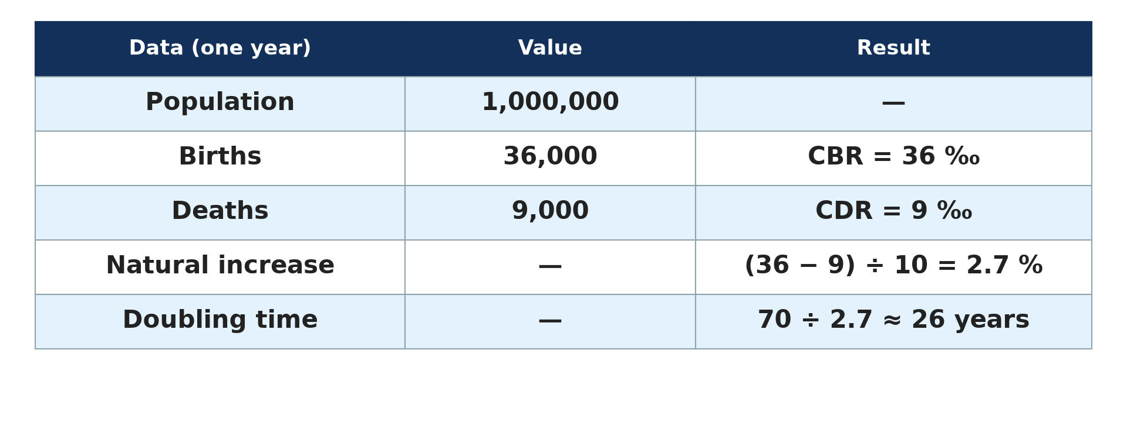
2. CALCULATIONS
Activity 2
Worked example.
Notes:
Activity 2. Look carefully at this diagram: worked example. Observe every detail before I ask the question.

Slide 23
2. CALCULATIONS
Activity 2: Question
Calculate the natural increase in percent.
Notes:
Here is the question for Activity 2: Calculate the natural increase in percent. Take one minute to think and write your answer in your rough notebook.

Slide 24
2. CALCULATIONS
Activity 2: Answer
(36 − 9) ÷ 10 = 2.7 %.
Notes:
Let us check the answer together. (36 − 9) ÷ 10 = 2.7 %.

Slide 25
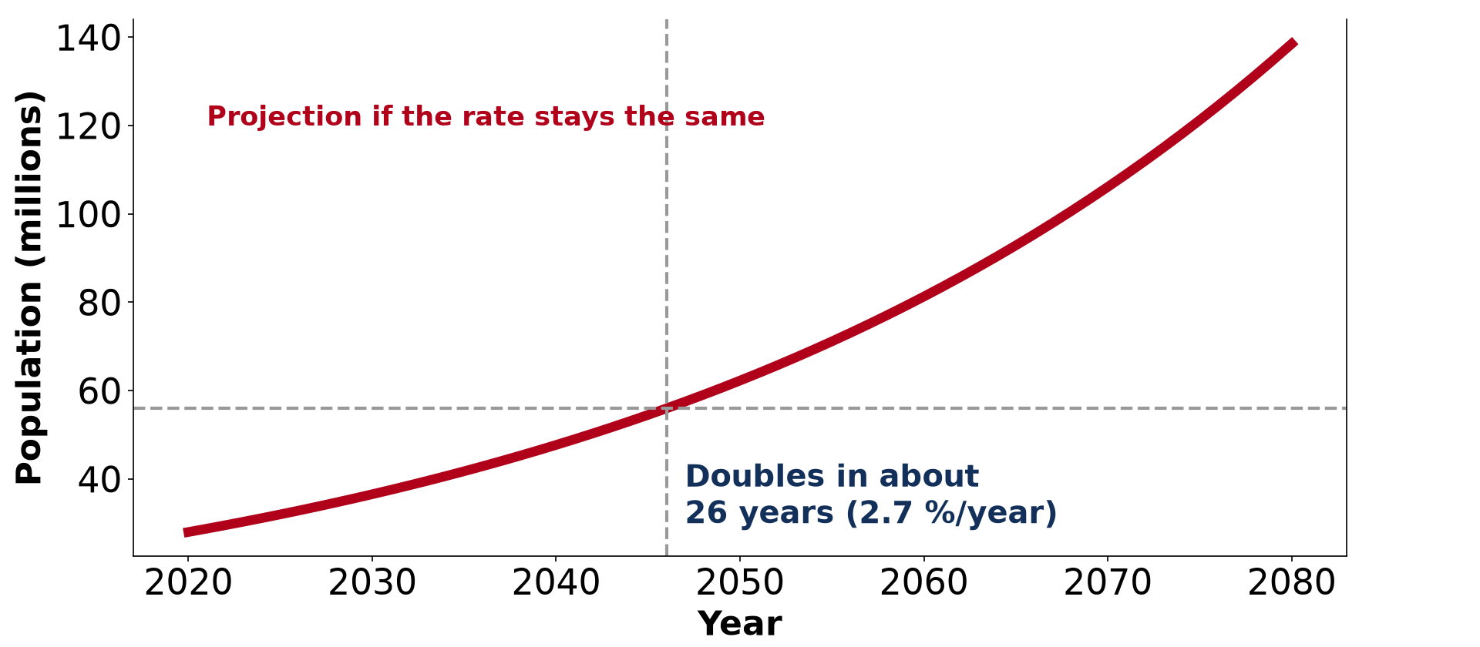
3. POPULATION PROJECTIONS AND DOUBLING TIME
Activity 3
A projection at 2.7 % per year.
Notes:
Activity 3. Look carefully at this diagram: a projection at 2.7 % per year. Observe every detail before I ask the question.

Slide 26
3. POPULATION PROJECTIONS AND DOUBLING TIME
Activity 3: Question
In how many years will the population double?
Notes:
Here is the question for Activity 3: In how many years will the population double? Take one minute to think and write your answer in your rough notebook.

Slide 27
3. POPULATION PROJECTIONS AND DOUBLING TIME
Activity 3: Answer
70 ÷ 2.7 ≈ 26 years.
Notes:
Let us check the answer together. 70 ÷ 2.7 ≈ 26 years.

Slide 28

4. NET MIGRATION
Activity 4
Travellers at a bus station.
Notes:
Activity 4. Look carefully at this picture: travellers at a bus station. Observe every detail before I ask the question.

Slide 29
4. NET MIGRATION
Activity 4: Question
A town receives 5,000 migrants and loses 2,000. What is its net migration?
Notes:
Here is the question for Activity 4: A town receives 5,000 migrants and loses 2,000. What is its net migration? Take one minute to think and write your answer in your rough notebook.

Slide 30
4. NET MIGRATION
Activity 4: Answer
+3,000.
Notes:
Let us check the answer together. +3,000.

Slide 31
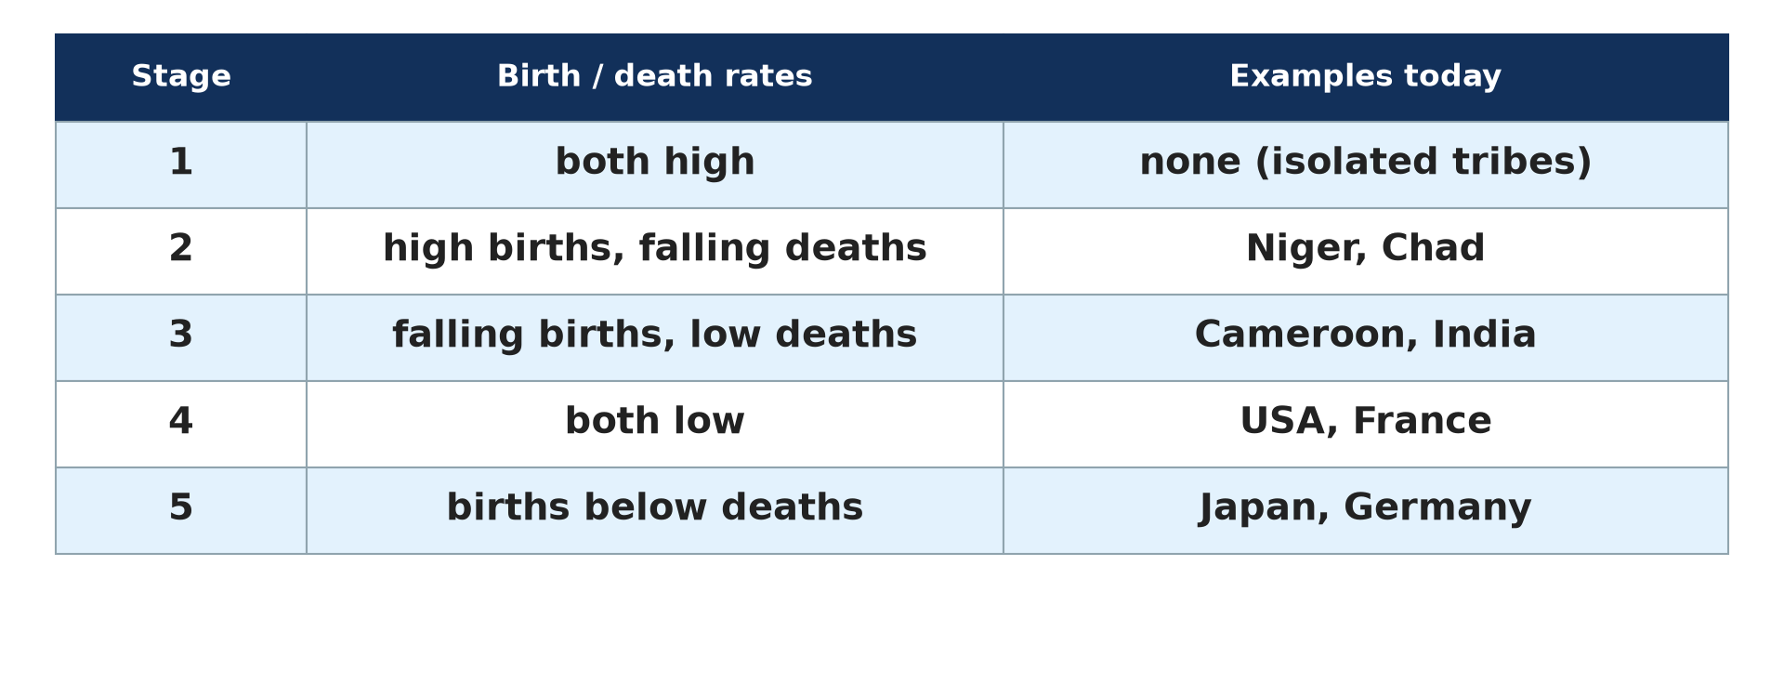
5. INTERPRETATION
Activity 5
Countries at different stages.
Notes:
Activity 5. Look carefully at this diagram: countries at different stages. Observe every detail before I ask the question.

Slide 32
5. INTERPRETATION
Activity 5: Question
A country has CBR 12 and CDR 10. Is it growing fast or slowly?
Notes:
Here is the question for Activity 5: A country has CBR 12 and CDR 10. Is it growing fast or slowly? Take one minute to think and write your answer in your rough notebook.

Slide 33
5. INTERPRETATION
Activity 5: Answer
Slowly (0.2 % per year), like a stage 4 country.
Notes:
Let us check the answer together. Slowly (0.2 % per year), like a stage 4 country.

Slide 34
BOARD SUMMARY
Board Summary
Topic: Population Change over Time (Population Growth)
Sub-topic: Population Growth
Practical Work 4: Calculating Demographic Indices
Notes:
Now we are going to copy the board summary. Write the title and the headings neatly in your notebooks. I will give you enough time for each slide, so do not rush.

Slide 35
BOARD SUMMARY
DEFINITIONS
The key terms of this lesson are defined as follows:
Fertility: It is the actual number of children born to women.
Fecundity: It is the biological ability of a woman to have children.
Notes:
Let us copy the definitions. The key terms of this lesson are defined as follows. On this slide we have Fertility and Fecundity. Write each point on a new line, with the key term first, and explain it in your own words when we revise.

Slide 36
BOARD SUMMARY
1. Formulas of Demographic Indices
The main indices are calculated as follows:
Crude birth rate (CBR): CBR = births in a year ÷ total population × 1,000. It is given per 1,000 people to compare countries.
Notes:
Let us copy Formulas of Demographic Indices. The main indices are calculated as follows. On this slide we have Crude birth rate (CBR). Write each point on a new line, with the key term first, and explain it in your own words when we revise. When you finish, we go to the next slide.

Slide 37
BOARD SUMMARY
1. Formulas of Demographic Indices (continued)
Crude death rate (CDR): CDR = deaths in a year ÷ total population × 1,000. Infant mortality rate = deaths under 1 year ÷ live births × 1,000.
Growth rate: Natural increase (%) = (CBR − CDR) ÷ 10. For example, (35 − 9) ÷ 10 = 2.6 %.
Notes:
We continue with Formulas of Demographic Indices. On this slide we have Crude death rate (CDR) and Growth rate. Write each point on a new line, with the key term first, and explain it in your own words when we revise.

Slide 38
BOARD SUMMARY
1. Formulas of Demographic Indices
Illustration: formulas of demographic indices
Notes:
Now draw this illustration in your notebook: formulas of demographic indices. Give it a title and label it clearly.

Slide 39
BOARD SUMMARY
2. Projections, Doubling Time and Migration
Other calculations include:
Doubling time: Doubling time ≈ 70 ÷ growth rate (%). At 2.6 %, a population doubles in about 27 years.
Notes:
Let us copy Projections, Doubling Time and Migration. Other calculations include. On this slide we have Doubling time. Write each point on a new line, with the key term first, and explain it in your own words when we revise. When you finish, we go to the next slide.

Slide 40
BOARD SUMMARY
2. Projections, Doubling Time and Migration (continued)
Population projection: Future population = present population × (1 + r)ⁿ, where r is the growth rate and n the number of years. It helps to plan services.
Net migration: Net migration = immigrants − emigrants. A town receiving 5,000 and losing 2,000 has a net gain of 3,000.
Notes:
We continue with Projections, Doubling Time and Migration. On this slide we have Population projection and Net migration. Write each point on a new line, with the key term first, and explain it in your own words when we revise.

Slide 41
BOARD SUMMARY
2. Projections, Doubling Time and Migration
Illustration: population projection and doubling time
Notes:
Now draw this illustration in your notebook: population projection and doubling time. Give it a title and label it clearly.

Slide 42
FORMATIVE EVALUATION
Evaluation 1
A town of 50,000 has 1,500 births. Find the CBR.
Notes:
Now let us check what you have understood. Question 1: A town of 50,000 has 1,500 births. Find the CBR. Answer in your exercise book.

Slide 43
FORMATIVE EVALUATION
Expected Answer
1,500 ÷ 50,000 × 1,000 = 30 ‰.
Notes:
The expected answer is: 1,500 ÷ 50,000 × 1,000 = 30 ‰. If you got it right, well done.

Slide 44
FORMATIVE EVALUATION
Evaluation 2
A population grows at 3.5 %. Find its doubling time.
Notes:
Now let us check what you have understood. Question 2: A population grows at 3.5 %. Find its doubling time. Answer in your exercise book.

Slide 45
FORMATIVE EVALUATION
Expected Answer
70 ÷ 3.5 = 20 years.
Notes:
The expected answer is: 70 ÷ 3.5 = 20 years. If you got it right, well done.

Slide 46
REMEDIATION
Remediation
Fill in the blanks:
Birth rate is given per ______ people.
Doubling time ≈ ______ ÷ growth rate.
Natural increase = (CBR − CDR) ÷ ______.
Notes:
For those who need more practice, fill in the blanks in your exercise book. The answers are: number 1, 1,000; number 2, 70; number 3, 10.

Slide 47
HOMEWORK
Homework
Find Cameroon's birth and death rates and calculate its natural increase and doubling time.
Notes:
For your homework: Find Cameroon's birth and death rates and calculate its natural increase and doubling time. We shall correct it at the beginning of our next lesson.

Slide 48
NEXT LESSON
Next Lesson
Our next lesson will be on:
Lesson 10: Factors of Population Growth
Notes:
Our next lesson will be on Lesson 10: Factors of Population Growth. Thank you for your attention, and see you next time.

Slide 49
BILINGUAL GAME
Bilingual Game (Jeu Bilingue)
English | Français
Rate | Le taux
Per thousand | Pour mille
Doubling time | Le temps de doublement
Projection | La projection
Fertility rate | L'indice de fécondité
Calculate | Calculer
Notes:
Let us play the bilingual game. I say a word in English, and you give me the French word. Then we do the reverse.

Slide 50
LOGBOOK
Official Logbook (1/2)
Module / Topic | Population Change over Time (Population Growth)
Lesson Title | Practical Work 4: Calculating Demographic Indices
Expected Learning Outcomes | Calculate CBR, CDR and natural increase. Calculate doubling time and make a simple projection. Calculate net migration and interpret results.
Competence | Learners are able to calculate and interpret the main demographic indices.
Notes:
I record this information in the official logbook of the class after the lesson.

Slide 51
LOGBOOK
Official Logbook (2/2)
Matter Taught | DEFINITIONS; Formulas of Demographic Indices; Projections, Doubling Time and Migration.
Evaluation | Formative evaluation and remediation exercise.
Homework | Find Cameroon's birth and death rates and calculate its natural increase and doubling time.
Enrolment / Present / Absent | ____ / ____ / ____
Achievement | To be completed after the lesson.
Notes:
I complete the second page of the logbook: the matter taught, the evaluation, the homework and the attendance.

Slide 52
TEACHER'S NOTE
Teacher's Note
Timing: Homework correction, plan, objectives 8 min | Recall, situation, action 10 min | 5 activities 30 min | Board summary (copying) 30 min | Evaluation, remediation 10 min | Homework, next lesson 5 min | Logbook 7 min
Without the projector (Activity 1): copy the formulas.
Without the projector (Activity 2): do each step on the board.
Without the projector (Activity 3): explain the rule of 70.
Without the projector (Activity 4): do the subtraction.
Without the projector (Activity 5): compare with the region.
Notes:
This slide is for me, the teacher: it gives the timing of the lesson and what to do if the projector is not available.

Slide 53
REFERENCES
References
National Geography Syllabus, MINESEC/IGE/IP-SS, 2019 — Module 4 (Population Geography).
Photo, Activity 4: “Wadi Halfa Bus Station” by D-Stanley, CC BY 2.0, via Flickr (https://www.flickr.com/photos/79721788@N00/8651154444)
Diagrams and animations: drawn for this lesson (Geography Department).
Notes:
These are the references and picture credits used to prepare this lesson.

